Slide 1
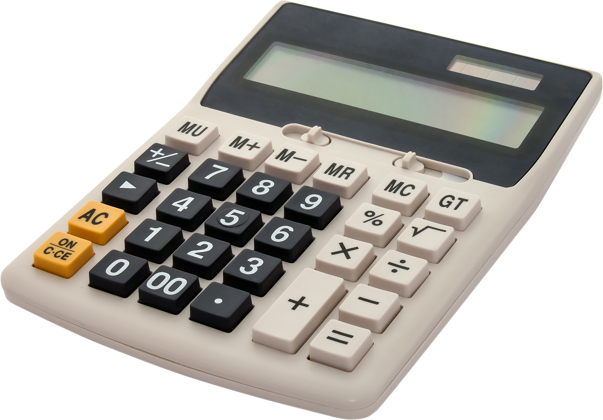
Building a GUI Calculator using Tkinter in Python—Project1
NEXT HIKES IT SOLUTIONS
By
CHETHANA S S
CALCULATOR

Slide 2
Introduction to Building a GUI Calculator
What is a GUI Calculator?
Why Use Tkinter for Python GUI?
A GUI Scientific Calculator is an application designed to facilitate complex mathematical calculations through a user-friendly graphical interface. Unlike traditional calculators that rely on text-based commands, a GUI calculator offers visual buttons and display screens, making it more intuitive and accessible for users.
Tkinter is the standard GUI toolkit for Python, included with most Python installations. Its built-in nature means there is no need for additional downloads. Tkinter's simple syntax allows for rapid development of applications with minimal code, making it ideal for developers at all skill levels.

Slide 3

Install Python
Begin by downloading the latest version of Python from the official site, python.org
Install Tkinter
Tkinter, the standard GUI toolkit for Python, typically comes pre-installed and then import Tkinter using 'import tkinter'. If no errors appear, you are ready to use Tkinter for your GUI projects.
Choose an IDE
Visual Studio Code, known for its flexibility and extensions and IDLE.
Create a New Python File
Once your environment is set up, create a new Python file for your scientific calculator project, naming it appropriately (e.g., 'calculator.py').

Slide 4
Designing the Calculator Interface
Creating a User-Friendly Calculator Layout with Tkinter
Importing Tkinter
importing the Tkinter library to access its features for building the GUI.
Defining the Layout
Utilizing the grid system, this section outlines how to effectively place buttons and the display for optimal user interaction.
Button Configuration
Buttons are created with specific commands
Creating the Main Window
This component establishes the main application window, setting its title to 'Scientific Calculator'.
Entry Display
The entry widget serves as the display area for user inputs and results

Slide 5
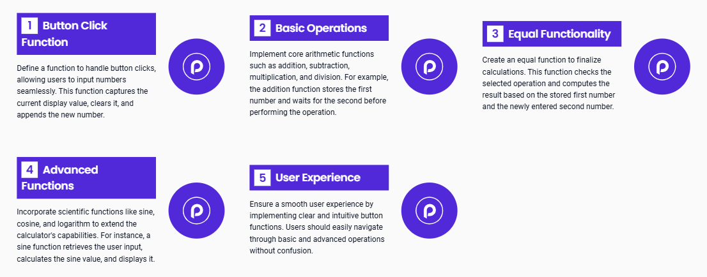
Implementing Calculator Functions
Enhancing Calculator Capabilities with Advanced Operations

Slide 6
Sources and references
Used for implementation of GUI calculator
GeeksforGeeks
Javapoint
Python Documentation
YouTube

Slide 7
Summary and conclusion
Essential Steps to Build a GUI Scientific Calculator Using Tkinter in Python
Understanding GUI
They allow users to engage with applications in an intuitive and user-friendly manner, making complex functions more accessible.
Designing the Interface
Tkinter provides various widgets that can be used to design an appealing interface.
Setting Up
It's essential to install Python and Tkinter, the library used for creating GUI applications. Choosing an Integrated Development Environment (IDE) that supports Python development is crucial for a smooth coding experience.
Implementing Functions
Incorporating both basic operations (addition, subtraction, multiplication, division) and advanced mathematical functionalities (trigonometric functions, exponentiation) is vital for a scientific calculator. This step requires careful coding to ensure accurate calculations.

Slide 8
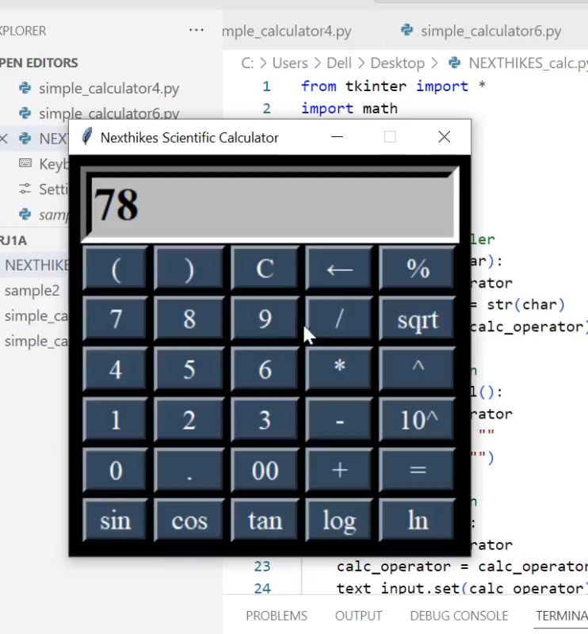
GUI CALCULATOR
Working video

Slide 9
Thank You.
CHETHANA S S
FABRIKAM RESIDENCES
9663736863
chethanaindpur@gmail.com
www.nexthikes.com

